Slide 1




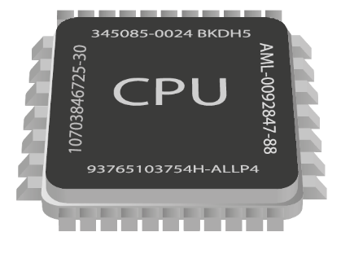
Asynchronous Programming
Writing Asynchronous Code in C#
Advanced
C#
SoftUni Team
Technical Trainers
Software University
http://softuni.bg

Slide 2

Table of Contents
Tasks in C#
What are Tasks?
async and await

Slide 3
Questions
sli.do #3569

Slide 4


Tasks in C#
Task Parallel Library

Slide 5
Tasks in C#
A task is a high-level representation of concurrent work
Runs in parallel with the main thread
May not run on a new thread (the CLR decides)
Offers several operations
Creating, running and returning result
Continuing another task (chaining several operations)
Proper exception handling
Progress/state reports

Slide 6
Generic Tasks
Task<T> is a task that will return a result sometime in the future
Result blocks the calling thread until the task returns a result
Task<long> task = Task.Run<long>(() =>
{
var primes = PrimesInRange(0, 1000000);
return primes.Sum();
});
// ...
Console.WriteLine(task.Result);
Blocking operation

Slide 7

Tasks in C#
Exercises in class

Slide 8
Tasks with async and await
The keywords async and await are always used together
async hints the compiler that the method might run in parallel
Does not make a method run asynchronously (await makes it)
Tells the compiler "this method could wait for a resource or operation"
If it starts waiting, return to the calling method
When the wait is over, go back to called method
static async void SliceFileAsync(string file, int parts)

Slide 9
Tasks with async and await (2)
await is used in a method which has the async keyword
Saves the context in a state machine
Marks waiting for a resource (a task to complete)
Resource should be a Task<T>
Returns T result from Task<T> when it completes
await DownloadStringAsync("http://softuni.bg");
Returns Task<string>

Slide 10
async and await – Example
static void Main()
{
DownloadFileAsync(FileUrl, "book.pdf");
...
}
static async void DownloadFileAsync(string url, string fileName)
{
Console.WriteLine("Downloading...");
await Task.Run(() =>
{
using (WebClient client = new WebClient())
{
client.DownloadFile(url, fileName);
}
});
Console.WriteLine("Download successful.");
Process.Start(fileName);
}
The calling thread exits the method on await
Everything after that is executed on another thread

Slide 11
async and await
Exercises in class

Slide 12

Helpful Resources
SoftUni Seminar on Concurrent C#
Article on Task API
Stephen Cleary Blog
https://softuni.bg/trainings/1021/Concurrent-Programming-in-C-Sharp
http://www.infoq.com/articles/Tasks-Async-Await
http://blog.stephencleary.com/

Slide 13
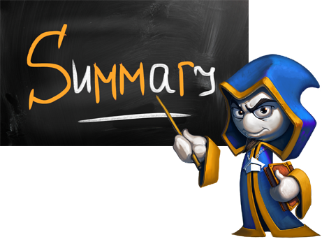
Summary
Tasks facilitate the work with multithreading
async and await keywords

Slide 14








Asynchronous Programming
https://softuni.bg/courses/advanced-csharp

Slide 15

License
This course (slides, examples, demos, videos, homework, etc.) is licensed under the "Creative Commons Attribution-NonCommercial-ShareAlike 4.0 International" license
Attribution: this work may contain portions from
"C# Fundamentals – Part 2" course by Telerik Academy under CC-BY-NC-SA license

Slide 16






Free Trainings @ Software University
Software University Foundation – softuni.org
Software University – High-Quality Education, Profession and Job for Software Developers
softuni.bg
Software University @ Facebook
facebook.com/SoftwareUniversity
Software University @ YouTube
youtube.com/SoftwareUniversity
Software University Forums – forum.softuni.bg

